Slide 1
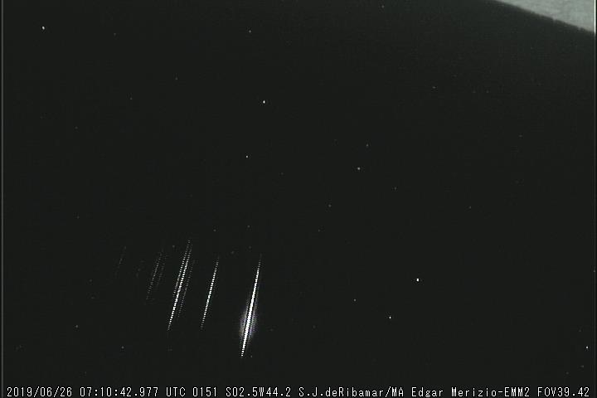
26 June 2019 Brazil meteor cluster
Pavel Koten, David Čapek
Department of Interplanetary Matter, AI CAS, Ondřejov
International Meteor Conference, Kutná Hora, 2024

Slide 2
Meteor clusters
Meteor clusters – fragmentation of meteoroids in the interplanetary space
Historical reports – Hapgood & Rothwell (1981), Piers & Hawkes (1993)
Leonid meteor storms – 1997, 2002:
- 3 clusters of 15 – 150 meteors within few seconds
September ϵ Perseid cluster (SPE) on 9 September 2016
(Koten et al., 2017, Čapek et al., 2022)
Huge cluster above Scandinavia on 30 October 2022
Detailed analysis, modelling, double station data

Slide 3
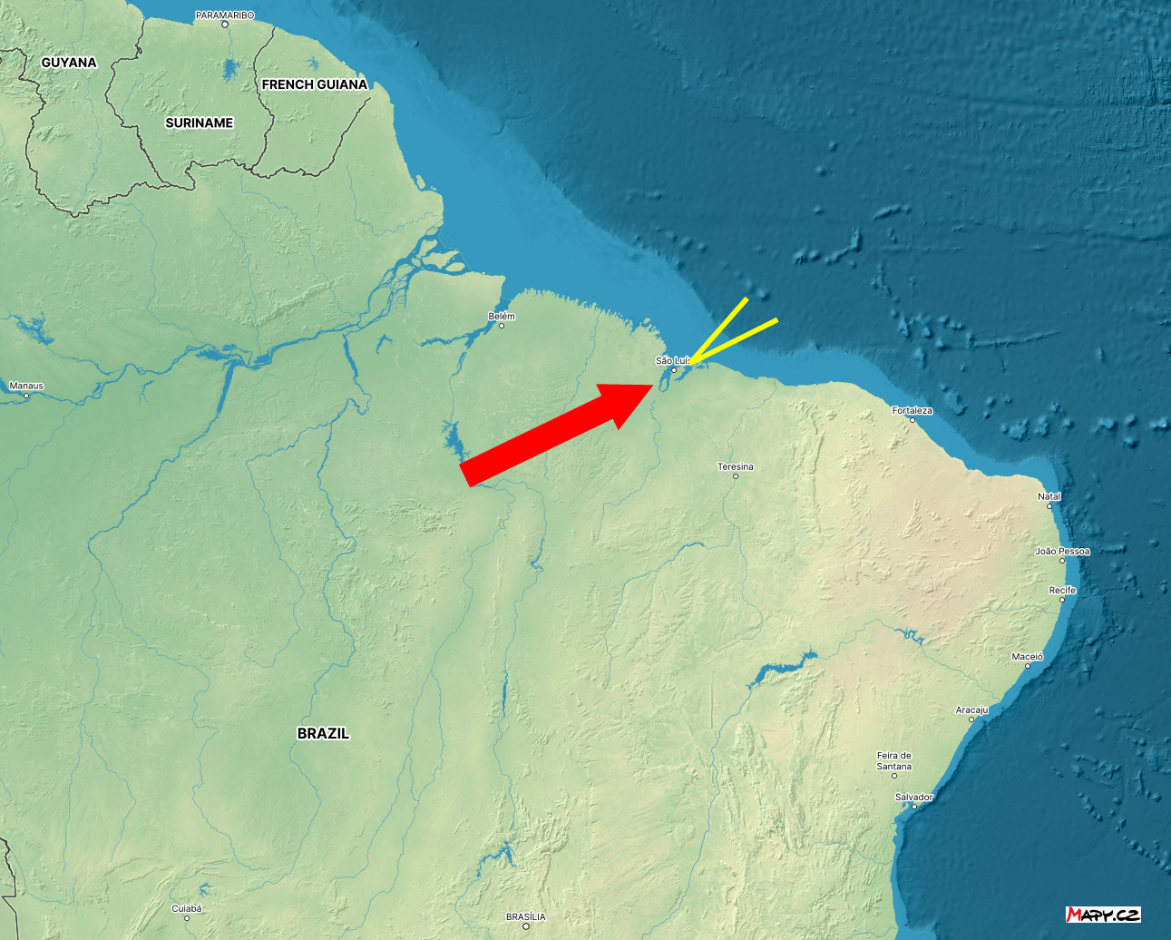
Observation, instrumentation
26 June 2019 at 7:10:43 UT
10 meteors within 0.5 second
BRAMON EMM2/MA station operated by Edgar Merizio
São Luís (2°28'21.72"S, 315°48'20.513"E, 81 m)
(northern Brazil)
only single station
Samsung SCB-2000
720x480 px, 30 fps
Az = 35°, elev = 45°

Slide 4
γ Sculptids (GSC)
Suspected shower membership
IAU MDC working list of meteor showers
First step – search for a single station solution consistent with this meteor shower
The brightest meteor – similar radiant but smaller velocity
Shower V_{G} = 63,5 km/s
Solution #1 V_{G} ~ 46 km/s

Slide 5
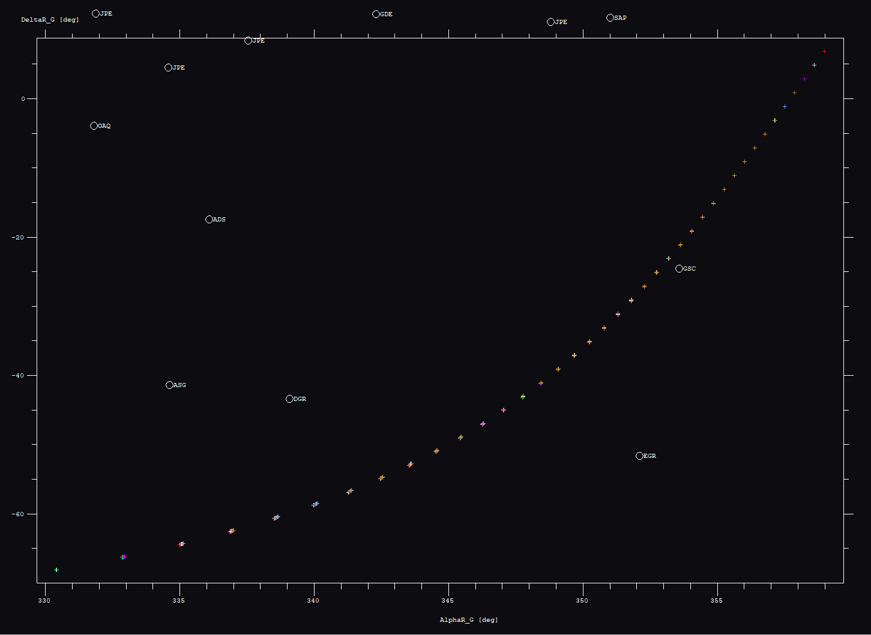
Single station solutions

Slide 6
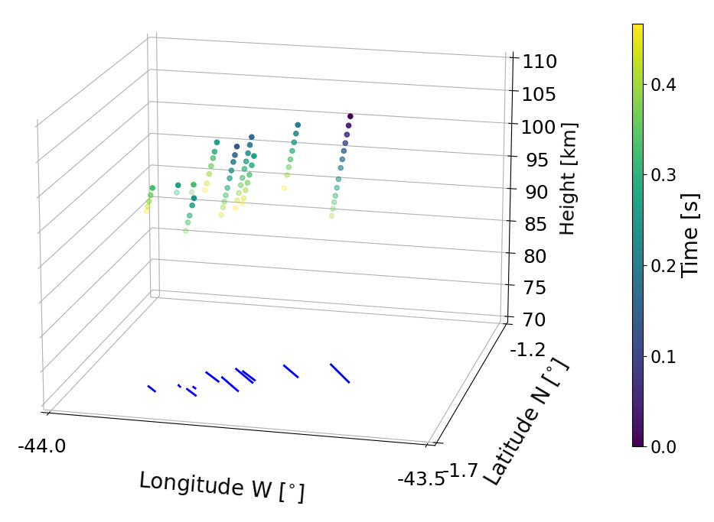
Solution #1 - GSC
GSC radiant, lower velocity (~ 46 km/s)
Beginning height between 99 and 110 km

Slide 7
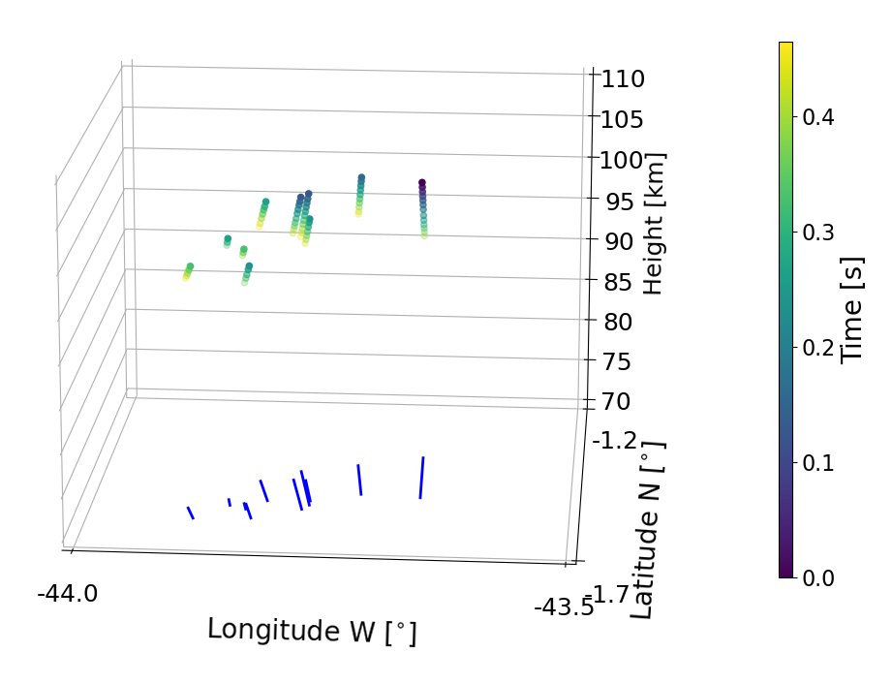
Solution #2
α_{G} = 340⁰, δ_{G} = -58.5⁰, V_{G} = 43,8 km/s (main fragment)
Beginning heights 99 – 107 km

Slide 8
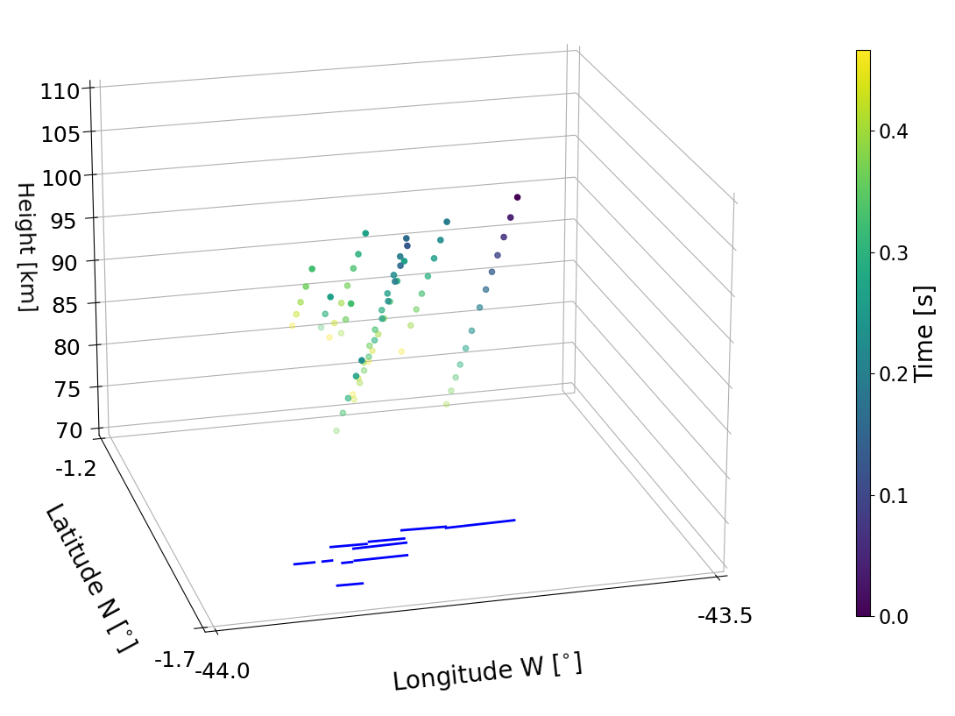
Solution #3
α_{G} = 357.5⁰, δ_{G} = -1.15⁰, V_{G} = 58.7 km/s
Beginning heights 95 – 108 km

Slide 9
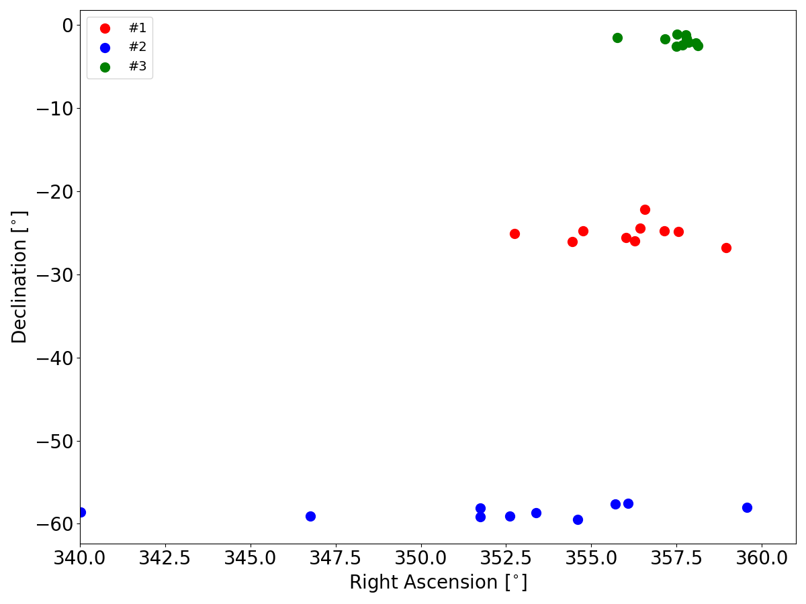
Geocentric radiant – 3 solutions

Slide 10
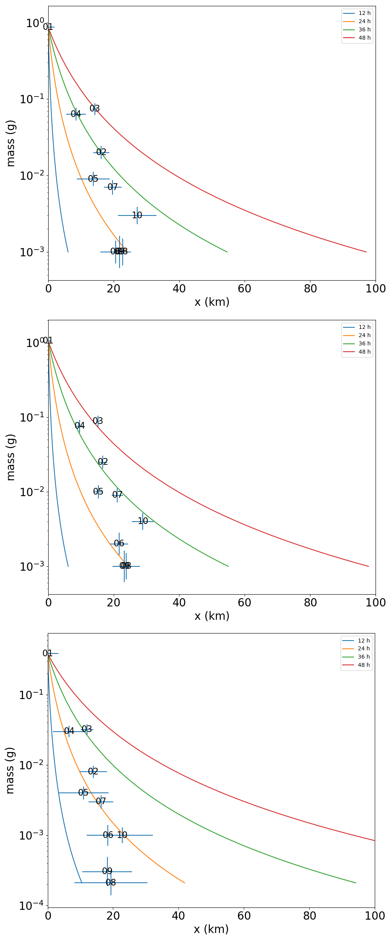
Fragments displacement
in antisolar direction
colour lines – zero ejection velocity, only solar
radiation pressure (different age of
the cluster)
crosses – measured values
solution #3 – approximately follows
age of 24 hours

Slide 11
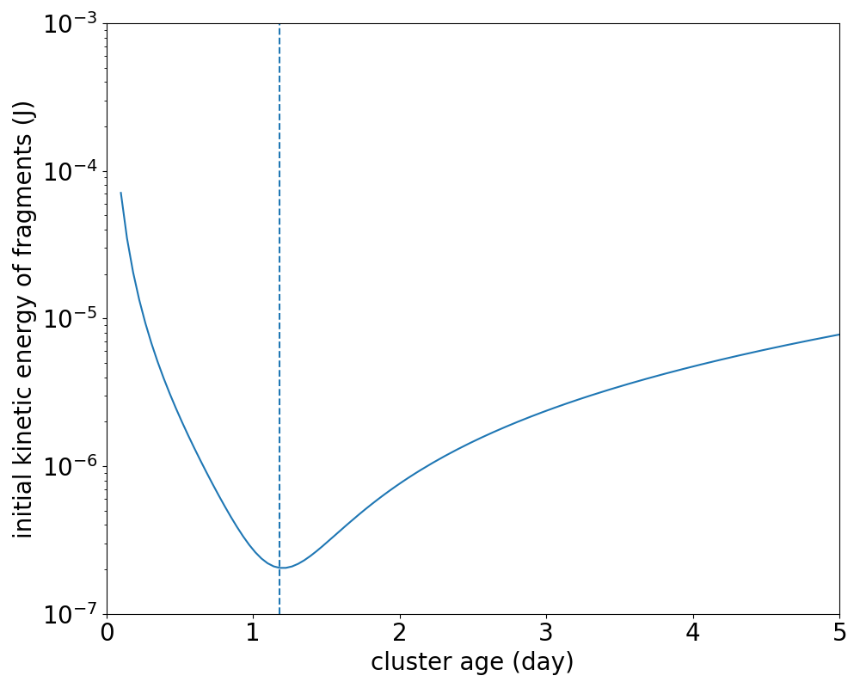
Age of cluster
Motion of meteoroids:
$${\vec{r}}_{i}=\frac{1}{2}{\vec{a}}_{i}t^{2}+{\vec{v}}_{i}^{ej}t,$$
$$i=0,…,9$$
t … time from ejection
v_{i} … ejection velocities
a_{i} … SRP acceleration
r_{i} … positions
Minimal value of total kinetic energy => age of cluster
#1 … 1^{d}11^{h},
#2 … 1^{d}14^{h},
#3 … 1^{d}4^{h} Ejection velocities – only few 0.1 m/s

Slide 12
Fragmentation scenarios
Collision – catastrophic or erosive (Grün et al., 1985)
target survived, small fragments separated => erosive
Rotational bursting (Čapek, 2014)
rotation of meteoroids accelerate due to reflected sunlight, bursting limit – release of fragments
Thermal stress
variable flux of incoming energy – temperature variations
can cause disintegration of the body or parts of it

Slide 13
Comparison
 | SPE | Scand. | TAH | Brazil
fragments | 10 | 22 | 51 | 10
area [km²] | 11 500 | 110 000 | 9 600 | 350
mass separation | YES | YES | NO | YES
age [days] | 2.28 ± 0.44 | 10.6 ± 1.7 | < 4 multiple? | 1.1
ejection velocity [m/s] | 0.13 – 0.77 | 0.16 – 0.61 | TBD | < 0.4
mechanism | thermal | thermal | TBD | thermal

Slide 14
Summary
Single station data on meteor cluster can provide us with very realistic atmospheric trajectories
Different solutions provide similar results – age of the cluster, ejection velocities, kinetic energy => origin
Brazil cluster:
Very compact – 350 km², 0.5 s
Very young – 1.1 day
Extremely low ejection velocities < 0.4 m/s

Slide 15
Acknowledgments
Work is supported by the GAČR grant no. 20-10907S, and institutional project RVO:67985815
Many thanks to Edgar Merizio and Marcelo Zurita (both BRAMON) for sharing of the original data
We will be happy if you can share data on the meteor clusters even single station ones!
Thank you for your attention!

